Slide 1

Sensing and Instrumentation Project
Jan – May 2022

Slide 2
Agenda
The team
Solution overview
Features to be implemented
Sensors to be used

Slide 3
Team no: 10
B. Srinidhi (EC20B1042)
Ravish Desh Anand (EC20B1052)
Yash Agrawal (EC20B1059)

Slide 4
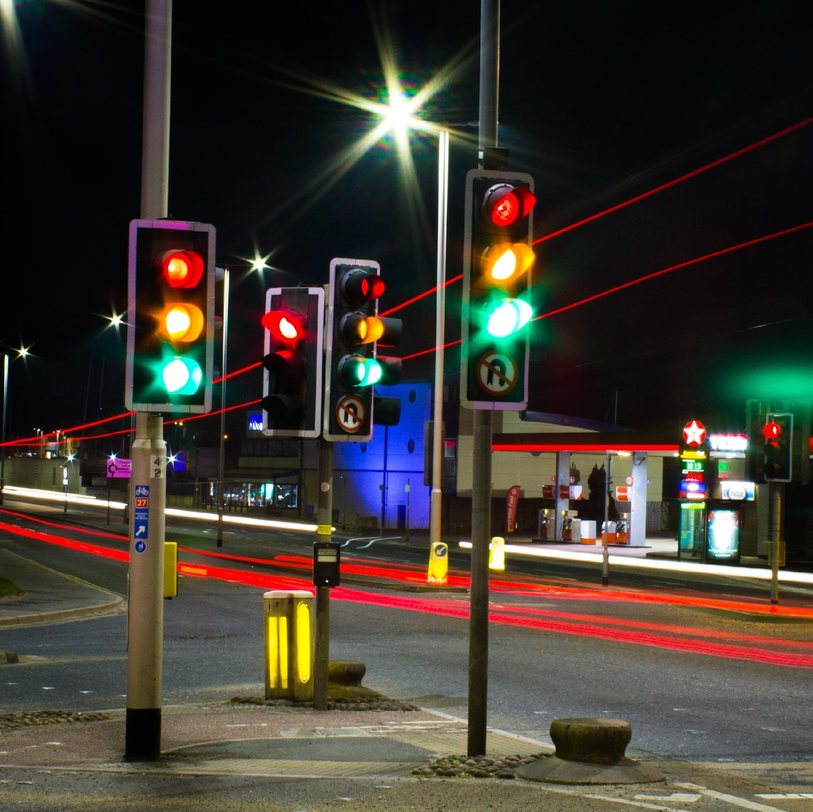
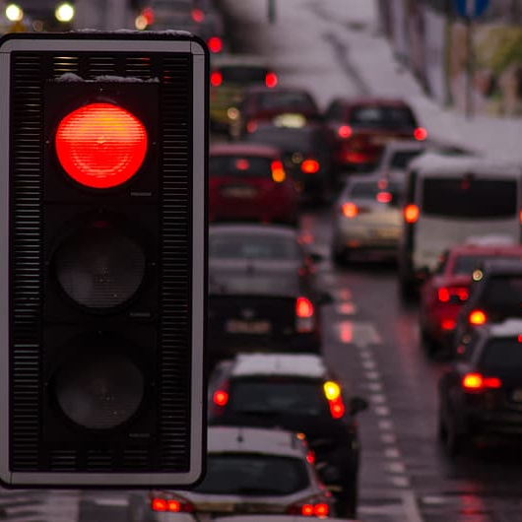
Problem Statement
Smart Traffic Lights
Traffic lights that change lights according to real time data of the vehicle density in junctions.

Slide 5
Solution overview
The underlying idea is the detection of Vehicles using RFID tags. A Radio frequency wave will be emitted by an RFID reader module, and RFID tags will be installed in cars. When the tag detects a frequency within the reader's range, it transmits the reader's unique ID.
When the reader receives the tag id and sends it to the processor, Id is treated as a vehicle by the processor.
Similarly, each Id is counted as a separate car, and the number of vehicles is then calculated as a traffic density. IR sensors are used to determine the speed of vehicles and subsequently estimate the number of incoming vehicles to the junction in the next few minutes.
As a result, traffic signal timing is changed in accordance with the number of vehicles on the road.

Slide 6
Features to be implemented
Car density based traffic control
Smart Pedestrian crossing system
Easy movement for emergency vehicles
Check for speeding and signal violation
Multi directional traffic control.
Each and every traffic control can be connected to monitor the traffic flow and make easy movement of traffic in a smart city environment.
(Seetharaman, 2020)

Slide 7
Start
Information from previous signal
RFID sensors detect cars in each side
PIRs sense speed of the vehicle
Does this side have maximum vehicles and no emergency vehicles in next ‘t’ seconds?
Emergency vehicles:?
More than speed limit?
Yes
Yes
Yes
Issue speeding tickets to vehicle based on unique RFID
Parallel pedestrian crossings: green signal
Green signal
More than ‘t’ seconds green and no emergency vehicle?
Communicate to next signal
Yes
Proposed Solution: Flowchart

Slide 8
Sensors to be used
RFID
A RFID reader is a device used to gather information from an RFID tag, which is used to track individual objects. Radio waves are used to transfer data from the tag to a reader.
RFID technology allows several items to be quickly scanned and enables fast identification of a particular product, even when it is surrounded by several other items.
IR Sensor
Infrared waves (with wavelengths from 0.75 to 1000 µm) can be used in many everyday applications.
An IR Sensor is an electronic device that measures and detects infrared radiation in the surrounding.
Two types of IR sensors, Active IR sensors consists of an LED and a receiver. When an object comes close, the light emitted gets reflected and is detected by the receiver, thus acting as proximity sensors. Passive IR sensors, on the other hand, can be used in motion detection systems.

Slide 9
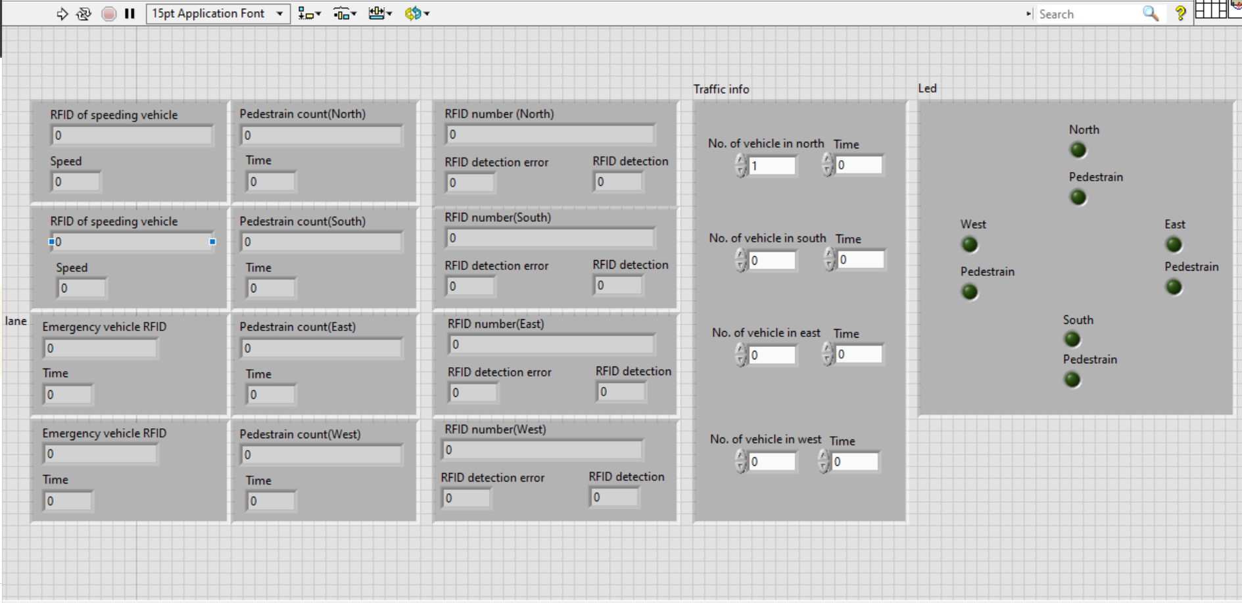
Preliminary Front Panel

Slide 10
Future Scope
Traffic control integrated with the car gps for its non-stop movement.
Real time data of each car based on the RFID tag.
Accident detection system.
Software and Hardware to be used:
LabVIEW
Arduino

Slide 11
References
L. F. P. de Oliveira, L. T. Manera and P. D. G. D. Luz, "Development of a Smart Traffic Light Control System With Real-Time Monitoring," in IEEE Internet of Things Journal, vol. 8, no. 5, pp. 3384-3393, 1 March1, 2021, doi: 10.1109/JIOT.2020.3022392.
M. Rodriguez et al., "A Gradient-Based Approach for Coordinating Smart Vehicles and Traffic Lights at Intersections," in IEEE Control Systems Letters, vol. 5, no. 6, pp. 2144-2149, Dec. 2021, doi: 10.1109/LCSYS.2020.3047332.
S. Faye and C. Chaudet, "Characterizing the Topology of an Urban Wireless Sensor Network for Road Traffic Management," in IEEE Transactions on Vehicular Technology, vol. 65, no. 7, pp. 5720-5725, July 2016, doi: 10.1109/TVT.2015.2465811.
G. L. Hamza-Lup, K. A. Hua, M. Le and R. Peng, "Dynamic Plan Generation and Real-Time Management Techniques for Traffic Evacuation," in IEEE Transactions on Intelligent Transportation Systems, vol. 9, no. 4, pp. 615-624, Dec. 2008, doi: 10.1109/TITS.2008.2006738.

Slide 12
Thank you

